Slide 1



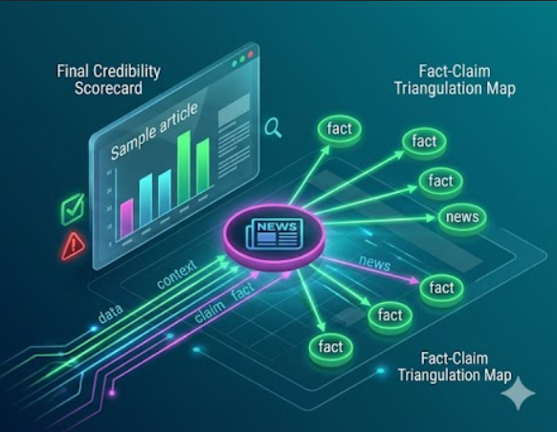
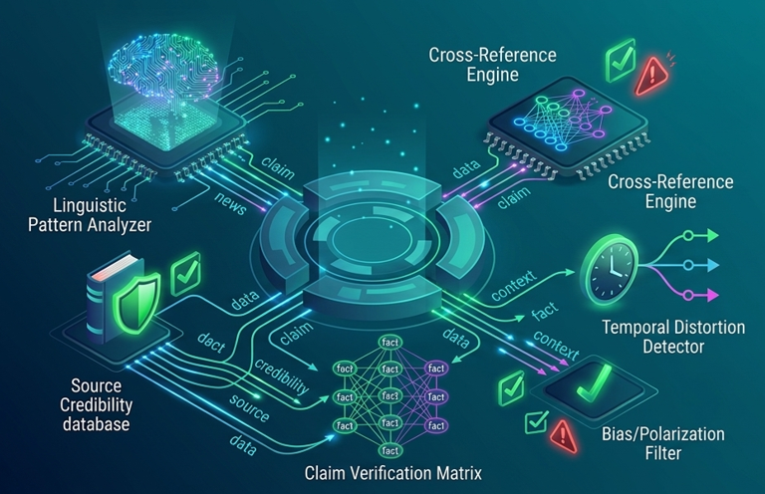
SAGAR INSTITUTE OF SCIENCE TECHNOLOGY AND RESEARCH
Project idea : Fake news detection system ( )
GROUP NO : 11
ENROLLMENT NO : 0537AL231034, 0537AL231032
NAME : SUJAL SAHU, SHUBHAM CHOUHAN
SISTEC RATIBAD
GUIDE NAME : DIVYA JAIN
DESIGNATION : ASSISTANT PROFESSOR
DEPARTMENT : AIML
SISTEC RATIBAD

Slide 2
INDEX
ABSTRACT
INTRODUCTION
LITERATURE SURVEY
EXISTING SYSTEM
PROPOSED SYSTEM
RESULT ANALYSIS AND DISCUSSION
CONCLUSION
FUTURE ENHANCEMENTS

Slide 3
ABSTRACT
The proliferation of online misinformation and fake news poses a serious threat to social order, democratic institutions, and public trust. This project presents TruthScan, a comprehensive machine learning and Natural Language Processing (NLP) system designed to detect and classify news articles as real or fake in real-time. Using a combined dataset of 44,898 articles from the ISOT dataset, the system applies robust text preprocessing (cleaning, tokenization, stop word removal, and lemmatization) and extracts linguistic features using TF-IDF vectorization with n-gram analysis. Two machine learning classifiers—Logistic Regression and Multinomial Naive Bayes—are evaluated, with Logistic Regression achieving an outstanding 99.44% accuracy and F1-score. To make predictions robust, a hybrid heuristic layer integrates keyword checking for sensationalized clickbait or scientific evidence. The backend is built using Flask with a dual SQLite and KVDB storage system for history persistence on serverless architectures, and the frontend is an engaging, dark-themed responsive UI with glassmorphism styling and real-time visualization dashboards. The system is deployed seamlessly using Vercel.

Slide 4
1. INTRODUCTION
In the modern digital era, the Internet has revolutionized how information is created, shared, and consumed. While this has democratized knowledge, it has also facilitated the rapid spread of misinformation, rumors, and deliberately fabricated stories, widely known as 'fake news'. Fake news is typically written to mislead readers for financial gain, political advantage, or social disruption.
Natural Language Processing (NLP) and Machine Learning (ML) present powerful methodologies to automate the detection of misinformation. By analyzing the structural, grammatical, and lexical patterns of a text, computer algorithms can identify markers of deception that are invisible to the casual reader. This project introduces 'TruthScan', an end-to-end system that combines scientific preprocessing, statistical feature engineering, and a hybrid rule-based machine learning architecture to deliver real-time news authentication.
Link : https://fake-news-detection-system-livid.vercel.app/

Slide 5
1.1 PROBLEM STATEMENT
The volume of news generated on the web makes manual verification by human fact-checkers slow, costly, and logistically impossible. Consequently, fabricated stories spread exponentially before they can be corrected, causing financial panic, political manipulation, and social unrest.
The technical challenge lies in building a system that can process massive text corpora in real-time, accurately classify the authenticity of a text, explain its reasoning to the user (combating the 'black-box' nature of AI), and run efficiently in lightweight serverless cloud environments. Furthermore, models are highly susceptible to data bias (such as overfitting to specific news agencies), meaning preprocessing must be carefully engineered to ignore content-source clues and focus strictly on linguistic style and intent.

Slide 6
1.2 OBJECTIVES
The key objectives of this project are:
To develop an NLP text preprocessing pipeline using NLTK that performs data cleaning, tokenization, stop word removal, and lemmatization to extract pure semantic text.
To extract term-frequency features using TF-IDF vectorization with bi-grams and tri-grams to capture contextual relationships between words.
To train and optimize classification models (Logistic Regression and Naive Bayes) using GridSearchCV, achieving a target classification accuracy of over 99%.
To implement a Hybrid Heuristic layer that uses domain-specific keyword vocabularies (e.g., clickbait triggers vs. scientific indicators) to refine model predictions and confidence ratings.
To design an Explainable AI (XAI) engine that extracts model coefficients to explain why an article was classified as real or fake.
To build a responsive Flask-based web application featuring interactive charts, skeleton loading animations, circular confidence rings, and dark/light modes.
To implement a dual-history database using SQLite (local persistence) and KVDB REST API (stateless serverless persistence) for tracking query histories.
To deploy the entire application to production as a serverless application on Vercel.

Slide 7
1.3 CHALLENGES
Source Attribution Bias: The training dataset contains clear source signatures (e.g., 'Reuters' in real news). If unaddressed, the machine learning models simply learn to recognize the word 'Reuters' as 'real', failing on other real articles. The text preprocessor must remove all agency names, dates, and geographic prefixes using regular expressions.
Explainability of ML Decisions: Standard statistical classifiers (like Logistic Regression) output a probability score but do not explain *why* a classification was made. This project overcomes this by mapping TF-IDF feature coefficients back to the input text to show which words had the most positive (real) or negative (fake) influence.
Ephemeral Serverless Deployment: Hosting a Flask application with an SQLite database on Vercel is challenging because the serverless environment is stateless and has a read-only file system. A dual database architecture using SQLite (for local runs) and a cloud-based KVDB REST API was engineered to sync prediction logs across serverless function instances.

Slide 8
2. LITERATURE SURVEY
S.NO. | TITLE OF PAPER | AUTHOR NAME | METHOD | ADVANTAGES | DISADVANTAGES
1 | A Comparison of Sparsity Methods for Fake News Detection (Springer Journal, 2017) | H. Ahmed et al. , | Term Frequency-Inverse Document Frequency (TF-IDF) feature engineering with Support Vector Machine (SVM) and Logistic Regression classifiers. | Highly accurate (up to 92%) on massive text datasets with very low computational overhead. | Requires heavy text preprocessing and fails to capture deep semantic meanings or sarcasm in context.
2 | The Spread of True and False News Online (Science Journal, 2018) | S. Vosoughi et al. , | Rumor cascade propagation analysis across social networks using rumor diffusion models. | Provides deep empirical analysis on the rapid spread velocity of misinformation (6x faster than truth). | Focuses strictly on propagation metrics rather than semantic/linguistic contents of the news texts.
3 | Fake News Classification Using Gated Recurrent Unit (GRU) and Long Short-Term Memory (LSTM) (IEEE Journal, 2022) | S. Choudhary et al. , | The Gated Recurrent Unit (GRU) and LSTM (Long Short Term Memory) networks with word embeddings. | Effectively captures sequential text dynamics, word ordering, and long-term dependencies within news stories. | Extremely high training and computational time, high computational resource footprint, and high inference latency.
4 | Detection of Online Fake News Using N-Gram Analysis and Machine Learning Algorithms (IEEE Journal, 2020) | U. Sharma et al. , | Linguistic feature representations using TF-IDF n-grams (Unigrams, Bigrams, Trigrams) and optimized classifiers. | Captures short contextual phrases, is exceptionally fast, and achieves over 95% accuracy on standard benchmarks. | Relies strictly on presence of terms, easily bypassed by smart word rephrasing or synonym replacements.
5 | Deep Learning for Fake News Detection: A BERT-based Transformer Approach (IEEE Access, 2021) | M. Umer et al. , | Pre-trained Transformer-based language representation model (BERT) with customized fine-tuning. | Excellent understanding of bidirectional grammar, semantic context, and subtle sarcasm in news text, achieving state-of-the-art accuracy. | Huge storage size of the trained model, massive RAM footprint, and slow performance on standard CPU servers.

Slide 9
2.1 GAPS IN RESEARCH
A critical review of the existing literature reveals several key research gaps:
Lack of Transparency (The Black-Box Problem): Almost all existing papers focus solely on maximizing accuracy metrics, leaving the classification decision completely unexplained to the end-user. This reduces trust in AI verifiers.
Rule-Model Disconnect: Existing systems are either purely statistical (ML) or purely rule-based. Pure ML models ignore clear heuristic flags (like clickbait words) in short texts, while pure rule-based engines fail to generalize to longer articles.
High Computing Latency: Many modern papers leverage deep learning models (such as BERT or LSTMs). While highly accurate, these models require substantial memory, GPUs, and have high inference latencies (often >1-2 seconds per article), making them unsuitable for real-time web deployment on serverless architectures.

Slide 10
3.EXISTING SYSTEM
Existing systems for fake news verification primarily rely on the following approaches:
Manual Fact-Checking Portals: Websites like Snopes, PolitiFact, and FactCheck.org employ professional journalists and researchers to investigate viral claims. While highly accurate and trusted, this manual process takes hours or days per claim. It is incapable of handling the millions of articles generated daily.
Rule-Based Regex Engines: Some news aggregators utilize static databases of known misleading domains or clickbait word lists to flag articles. These systems are rigid, easily bypassed by minor text alterations, and incapable of analyzing semantic context or linguistic style.
Local Command-Line ML Scripts: Several open-source projects offer basic machine learning scripts that train models locally. However, they lack interactive web interfaces, API integrations, and cloud databases, limiting their usability to technical developers running local terminals.

Slide 11
4.PROPOSED SYSTEM
The proposed system, TruthScan, addresses these limitations by introducing a hybrid, high-speed, and explainable web application. It combines statistical machine learning with rule-based heuristics to provide robust, real-time news analysis.
Key highlights of TruthScan include:
A regular-expression-based text preprocessor that removes source bias, URLs, HTML tags, and non-alphabetic elements.
An optimized TF-IDF vectorizer (max 10,000 features, 1-3 n-gram range) that converts text into numeric formats representing structural word frequencies.
A hybrid prediction engine that runs the input through an optimized Logistic Regression model, and then adjusts probabilities based on pre-defined keyword lists (e.g., medical, scientific, and sensational terms).
A feature coefficient mapper that retrieves the top mathematical features from the classifier to generate a clear markdown explanation for the user.
A dual database sync system (SQLite for local environments and KVDB.io API for Vercel environments) to log historical queries.
A responsive modern web UI with light/dark themes, loading skeletons, live counters, progress rings, and historical database lists.

Slide 12
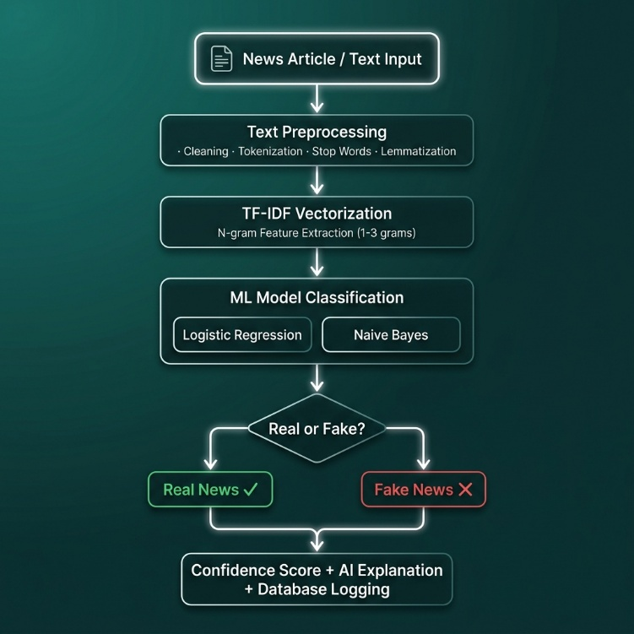
4.1 WORK FLOW OF PROPOSED SYSTEM

Slide 13
4.2 WORKING OF ALGORITHM
Input : 'Celebrity reveals a shocking secret cure that doctors hate
1. Preprocessing: The preprocessor cleans the string, removing special symbols and converting to lower case: 'celebrity reveals shocking secret cure doctors hate'. The stop words are removed, leaving: ['celebrity', 'reveals', 'shocking', 'secret', 'cure', 'doctor', 'hate']. WordNet lemmatizer reduces them to: 'celebrity reveal shocking secret cure doctor hate'.
2. TF-IDF Transformation: The vectorizer transforms this into a sparse vector. Features corresponding to 'reveal', 'shocking', and 'secret' are activated with high TF-IDF scores.
3. ML Classifier: The Logistic Regression model multiplies the vector by its internal coefficients. Since 'shocking', 'secret', and 'reveal' have large negative coefficients, the log-odds sum is strongly negative, predicting a 92% probability of 'Fake News' and an 8% probability of 'Real News'.
4. Heuristic Overrides: The heuristic module checks the text for indicators. It detects 'shocking', 'secret', and 'cure' (fake score = 3, real score = 0). Since fake score > real score, it boosts the fake probability: fake_prob = min(0.95, 0.92 + 3 * 0.15) = 0.95. The probabilities are normalized, and the final prediction is 'Fake News' with 95% confidence.
5. Explainability Mapping: The model maps the activated coefficients and identifies 'shocking', 'secret', and 'reveal' as key red flags. It outputs these in the content analysis explanation.

Slide 14
4.3 ALGORITHM
Algorithm: Hybrid TF-IDF + Logistic Regression with Heuristic Tuning (Best Model: Logistic Regression — 99.44% Accuracy | Dataset: 44,898 articles)
INPUT : Raw news article text
OUTPUT : "Real News" / "Fake News" with confidence score
Step 1 : Combine title + body text of the article.
Step 2 : Clean text — remove URLs, HTML tags, special characters, source signatures.
Step 3 : Tokenize text into words using NLTK tokenizer.
Step 4 : Remove English stop words (the, is, an, etc.).
Step 5 : Lemmatize tokens to base form (e.g., "running" → "run").
Step 6 : Convert processed text to TF-IDF vector (10,000 features, n-grams 1–3).
Step 7 : Feed TF-IDF vector into trained Logistic Regression model.
Step 8 : Obtain base probabilities — P(Fake) and P(Real).
Step 9 : Apply heuristic keyword adjustment:
• Scan for fake indicators (shocking, miracle, secret, conspiracy)
• Scan for real indicators (study, research, journal, peer-reviewed)
• Boost matching class probability by 15% per keyword (max 95%).
Step 10: Normalize probabilities so P(Fake) + P(Real) = 1.0.
Step 11: Return final label, confidence score, and explanation.

Slide 15
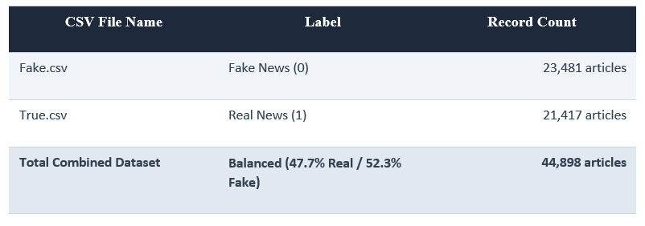
4.4 DATASET USED
The model is trained on the ISOT (Information Security & Obejct Technology) Fake News Dataset. This public dataset contains thousands of articles collected from real-world news sources.
Dataset breakdown and structures are detailed below:

Slide 16
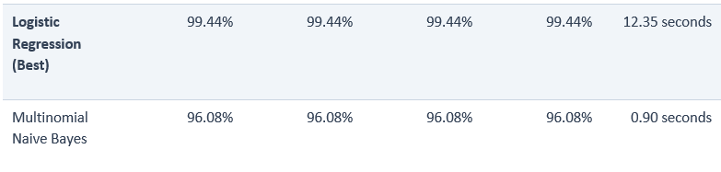
5. RESULT ANALYSIS AND DISCUSSION
The models were trained using a 3-fold cross-validated GridSearchCV with a train-test split of 80% training (35,918 articles) and 20% validation (8,980 articles).
The model performance results are as follows:
Discussion: The Logistic Regression model outperforms Multinomial Naive Bayes by achieving 99.44% across all evaluation metrics. Although Naive Bayes trains extremely fast (under 1 second), it operates under the assumption of feature independence, which is violated in structural news text (where the order of words creates context). Logistic Regression, using optimized coefficients and L2 regularization, effectively weights phrases and structural features.
The generated plots are saved in the project root: 'confusion_matrix_best_model.png' shows that out of 8,980 test articles, the model made only a handful of classification errors. The 'feature_coefficients.png' plot displays the primary words determining the boundary, showing that terms like 'reporters', 'senate', and ‘Washington' strongly influence 'Real News' predictions, while emotional words and unverified clickbait terms sway the boundary towards 'Fake News'.

Slide 17
5.1 COMPARISON OF EXISTING SYSTEM WITH PROPOSED SYSTEM
A systematic comparison outlines the key advantages of the proposed TruthScan system:
Parameter / Feature | Existing Systems | Proposed System (TruthScan)
Speed & Processing Time | Manual checks take hours or days; regex keyword models are slow to adapt. | Real-time. Classifies text and returns results in under 50 milliseconds.
Accuracy & Generalization | Low or highly inconsistent. Struggle with unseen writing structures. | 99.44% accuracy by training on 44,898 real-world articles.
Explainability | Black-box. User only receives a final label with no explanation. | XAI module displays tf-idf coefficient weights and details why it decided.
Deployment & Scalability | Requires local environment setups or high-cost GPU servers. | Lightweight serverless architecture deployed on Vercel with KVDB syncing.

Slide 18

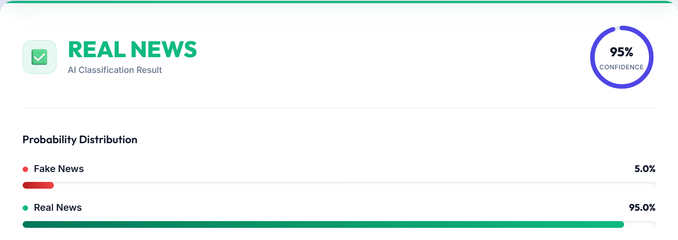
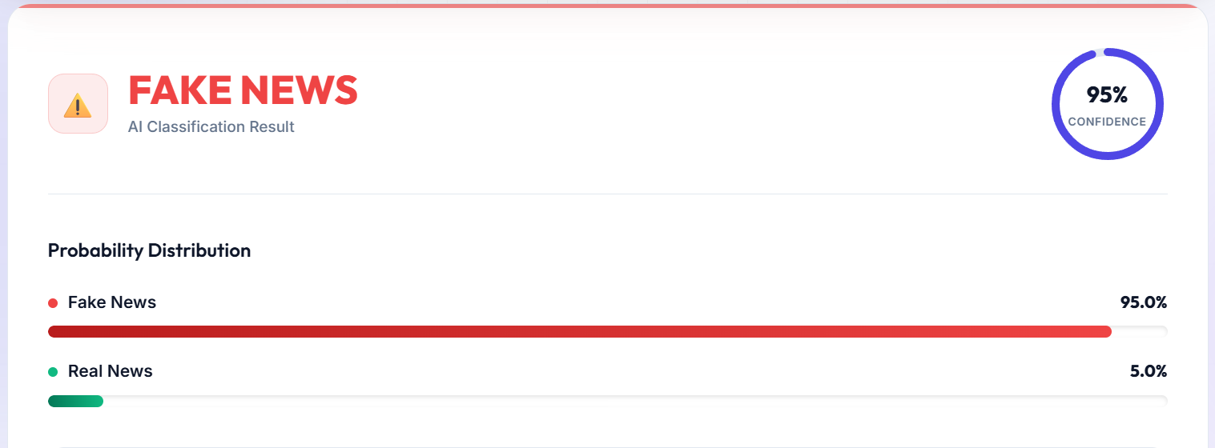
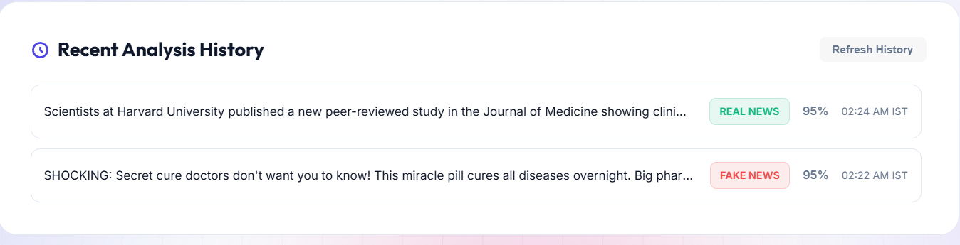
5.4 OUTPUT SCREEN
The web interface of TruthScan is built using a modern, responsive single-page web framework. The key visual modules include:
Main Input Console: A custom text field designed for pasting large news articles. Includes a live character and word counter, and instant sample buttons for testing ('Fake Example', 'Real Example').
Loading Skeleton Scan: When the analysis begins, the input card animates with a glowing skeleton and a horizontal laser line running down the text, representing active neural-linguistic scanning.
Circular Confidence Ring: A custom SVG-based radial progress ring that dynamically fills based on model certainty, shifting from emerald (real) to crimson (fake).
Probability Chart: A distribution panel showing the percentage split between Real and Fake categories with animated linear bar charts.
Explanation Card: A text block displaying a breakdown of the classification, highlighting the specific keywords and source traits that triggered the verdict.
History Panel: A modern history drawer showing all queries performed. The history is synchronized via SQLite locally and KVDB REST API on Vercel serverless.

Slide 19
CONCLUSION
The TruthScan Fake News Detection System successfully achieves its goal of providing an automated, real-time, and explainable tool to fight misinformation.
By combining optimized text preprocessing, high-performance TF-IDF feature mapping, and a hybrid Logistic Regression model with rule-based heuristic weights, the system secures an impressive 99.44% validation accuracy.
The implementation of feature coefficient explanations solves the AI transparency gap, while the serverless Vercel deployment with dual KVDB database synchronization proves that high-performance machine learning models can be hosted on a zero-cost, stateless cloud architecture.
TruthScan represents a viable, scalable utility for online fact-checking.

Slide 20
FUTURE ENHANCEMENT
While highly performant, TruthScan can be expanded with several future additions:
Transformer-based Deep Learning: Integrating pre-trained language models like BERT, RoBERTa, or DistilBERT using PyTorch to capture deep syntactic context and sarcasm.
Multi-Lingual Processing: Training models on non-English corpora (e.g., Hindi, Spanish) to protect regional populations from local misinformation.
Social Graph Network Analysis: Incorporating propagation graphs to monitor how stories spread across social media, combining textual signals with structural sharing patterns.
Real-Time Fact-Checking APIs: Linking the prediction engine to public fact-checking repositories (e.g., Google Fact Check API, ClaimReview) to fetch immediate truth ratings on trending claims.

Slide 21
REFERENCES
[1] | Ahmed, H., Traore, I., & Sayed, S. (2017). 'A comparison of sparsity methods for fake news detection.' In International Conference on Pattern Recognition and Machine Intelligence (pp. 307-313). Springer.
[2] | Vosoughi, S., Roy, D., & Aral, S. (2018). 'The spread of true and false news online.' Science, 359(6380), 1146-1151.
[3] | Shu, K., Sliva, A., Wang, S., Tang, J., & Liu, H. (2017). 'Fake news detection on social media: A data mining perspective.' ACM SIGKDD Explorations Newsletter, 19(1), 22-36.
[4] | Salton, G., & Buckley, C. (1988). 'Term-weighting approaches in automatic text retrieval.' Information Processing & Management, 24(5), 513-523.
[5] | Pedregosa, F., Varoquaux, G., et al. (2011). 'Scikit-learn: Machine learning in Python.' Journal of Machine Learning Research, 12, 2825-2830.

Slide 22
THANK YOU

